Slide 1
Python for Data Science
DataMind

Slide 2
Introduction
Background
Jelmer Offenberg
MSc Information Sciences
MSc Artificial Intelligence
Career
Current:
Co-founder of DataMind
Machine Learning Engineer at Ahold
Past:
Data scientist at Transavia
Background
Bas van der Drift
MSc Artificial Intelligence
Career
Co-founder of DataMind
Analytics future state product owner at ABN AMRO

Slide 3
Learning objectives
Getting acquainted with Python
Leveraging Python to solve day to day data science problems
Feel free to ask anything!

Slide 4
R vs Python
Statistics
Research
Engineering
Computer science
Development
Notes:
Waarom ik Python gebruik:
Makkelijke syntax (leesbaarheid, leerbaarheid)
Open source en populair dus veel ondersteuning en packages
Flexibele en krachtige integratie met andere systemen

Slide 5
Real world use cases

Slide 6
Inflight Sales Forecasting
Business Problem
Too much waste on perishable goods due to poor inventory management.
The goal
Develop a data-driven application that automatically generates load plans for aircraft.
The result
Flight operations at Rotterdam & Eindhoven reduced their waste by 60%.
https://www.linkedin.com/pulse/how-data-driven-aircraft-loading-reduces-waste-jelmer-offenberg/

Slide 7
Inflight Sales Forecasting
Data Collection
Data Cleaning
Data Modelling
Deployment
Reporting
SQL
SQL
Scikit Learn
Scikit Learn
Azure DevOps
Power BI
PySpark
PySpark
PySpark
PySpark
LightGBM
LightGBM
SQLAlchemy
SQLAlchemy
Pandas
Pandas
Pandas
Pandas
Airflow
Airflow

Slide 8
Website Personalization
Business Problem
It is too difficult and inefficient to maintain a rule based website optimization application that decides which content is shown to which client.
The goal
Develop a self-learning solution that optimizes which content to show to clients based on their needs and interests.
The result
Marketeers spend their time doing marketing instead of managing complex rules
Conversions have increased by ~65%
Notes:
A conversion here is a click - so not sales but customer interest driven
Practically unlimited content can be added to the system

Slide 9




Content personalization
MB app + abnamro.nl
recommendation engine
behavioural data
+
‘static’ client data
marketing reports
Notes:
Prediction models based on behavioural and static customer data generate recommendations
Content is shown to clients
Their behaviour wrt this content is logged and used for further training of the models automatically

Slide 10
Python basics

Slide 11
Basics
1
Data types & structures in Python - a quick recap.

Slide 12
Data Types & Structures
Data Types Example
String ‘Python’
Integer 40
Float 40.50
Datetime 2019-06-14T10:00:00
Data Structures Example
List [‘python’, 40, 42.50]
Tuple (40, ‘python’)
Set {40, 50, 60}
Dict {‘name’: ‘python’,
‘value’: 42}

Slide 13
Basics
2
Looping & flow control - a quick recap.

Slide 14
Looping in Python
The for-loop
[pseudocode]
for each item in some list
do some action
[python code]
items = [‘Python’, ‘Pandas’, ‘PySpark’]
for item in items:
print(item)
[output]
Python
Pandas
PySpark
The while-loop
[pseudocode]
while something is true
do something
[python code]
x = 0
while x < 5:
print(x)
x += 1
[output]
0
1
2
3
4

Slide 15
Data Handling
3

Slide 16

Working with multiple files
 | A | B | C | Source
0 | 10 | 20 | 7 | File 1
1 | 30 | 15 | 10 | File 1
2 | 5 | 24 | 16 | File 2
: | : | : | : | :
n | 15 | 8 | 26 | File n
File 1
File 2
File 3
File 4
CSV, JSON, XML, XLSX, TXT, TSV, etc.

Slide 17
Exercise
Data handling in python

Slide 18
Data handling exercise
https://tinyurl.com/wxtnea2

Slide 19
Pandas
Python Data Analysis Library

Slide 20
Reading data using Pandas
# Import pandas library
import pandas as pd
# Create data variable
data = pd.read_csv(filepath_or_buffer=‘/path/to/file.csv’, sep=’|’, header=True)
Argument
Argument
Argument
https://pandas.pydata.org/pandas-docs/stable/reference/api/pandas.read_csv.html#pandas.read_csv

Slide 21
Pandas Dataframe explained
Data frames consist of columns with values, these columns are called Series.
20
15
40
32
NL
DE
BE
FR
Shape: (4, 1)
Type: Pandas Series
Data type: Integer
Shape: (4, 1)
Type: Pandas Series
Data type: String

Slide 22
Pandas DataFrame explained
Multiple Series make a Pandas DataFrame.
 | A | B | C | Source
0 | 10 | 20 | 7 | File 1
1 | 30 | 15 | 10 | File 1
2 | 5 | 24 | 16 | File 2
: | : | : | : | :
n | 15 | 8 | 26 | File n
DataFrame Properties
A DataFrame is two-dimensional
Potentially columns are of different types
Size – Mutable (add and remove rows and columns)
Labeled axes (rows and columns)
Can Perform arithmetic operations on rows and columns

Slide 23
Pandas DataFrame explained
Multiple Series make a Pandas DataFrame.
Column names
Index
 | A | B | C | Source
0 | 10 | 20 | 7 | File 1
1 | 30 | 15 | 10 | File 1
2 | 5 | 24 | 16 | File 2
: | : | : | : | :
n | 15 | 8 | 26 | File n
DataFrame Properties
A DataFrame is two-dimensional
Potentially columns are of different types
Size – Mutable (add and remove rows and columns)
Labeled axes (rows and columns)
Can Perform arithmetic operations on rows and columns
Series

Slide 24
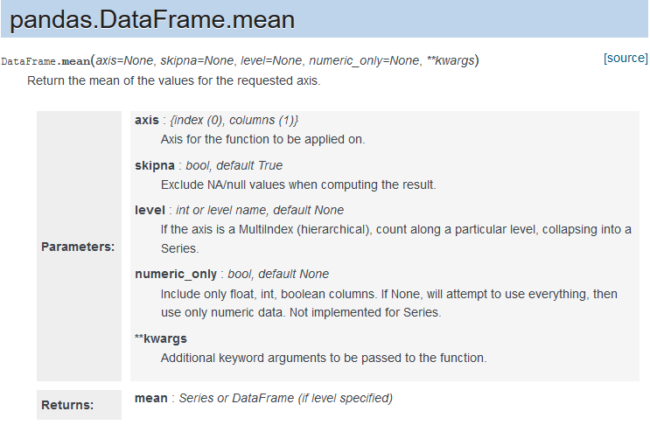
Pandas DataFrame operations
DataFrame operations can be done rows-wise or column-wise
 | A | B | C | Source
0 | 10 | 20 | 7 | File 1
1 | 30 | 15 | 10 | File 1
2 | 5 | 24 | 16 | File 2
: | : | : | : | :
n | 15 | 8 | 26 | File n
df =

Slide 25
DataFrame axes explained
Axis 0 will act on all the ROWS in each COLUMN
Axis 1 will act on all the COLUMNS in each ROW
 | A | B | C
0 | 10 | 20 | 7
1 | 30 | 15 | 10
2 | 5 | 24 | 16
3 | 15 | 8 | 26
12.33
18.33
df =
df.mean(axis=1)
15
16.33
15
16.75
14.75
df.mean(axis=0)

Slide 26
Selection
 | A | B | C | Source
0 | 10 | 20 | 7 | File 1
1 | 30 | 15 | 10 | File 1
2 | 5 | 24 | 16 | File 2
: | : | : | : | :
n | 15 | 8 | 26 | File n
df =

Slide 27
Selection - column
 | A | B | C | Source
0 | 10 | 20 | 7 | File 1
1 | 30 | 15 | 10 | File 1
2 | 5 | 24 | 16 | File 2
: | : | : | : | :
n | 15 | 8 | 26 | File n
df =
df[‘B’]

Slide 28
Selection - columns
 | A | B | C | Source
0 | 10 | 20 | 7 | File 1
1 | 30 | 15 | 10 | File 1
2 | 5 | 24 | 16 | File 2
: | : | : | : | :
n | 15 | 8 | 26 | File n
df =
df[[‘B’, ‘C’]]

Slide 29
Selection - integer location
 | A | B | C | Source
0 | 10 | 20 | 7 | File 1
1 | 30 | 15 | 10 | File 1
2 | 5 | 24 | 16 | File 2
: | : | : | : | :
n | 15 | 8 | 26 | File n
df.iloc[1]
df =

Slide 30
Selection - integer location
 | A | B | C | Source
0 | 10 | 20 | 7 | File 1
1 | 30 | 15 | 10 | File 1
2 | 5 | 24 | 16 | File 2
: | : | : | : | :
n | 15 | 8 | 26 | File n
df =
df.iloc[1:3]
Notes:
[1:3] waarom 1:3 ->

Slide 31
Selection - integer location
 | A | B | C | Source
0 | 10 | 20 | 7 | File 1
1 | 30 | 15 | 10 | File 1
2 | 5 | 24 | 16 | File 2
: | : | : | : | :
n | 15 | 8 | 26 | File n
df.iloc[1][[‘B’, ‘C’]]
df =

Slide 32
Filtering
What if we want to look at rows and columns containing specific values?
All rows where last_name is equal to ‘Johnson’
The age and country_of_birth of people named ‘Johnny’
… or more abstract, all rows where the value in column B equals 15

Slide 33
Filtering - loc instead of iloc
 | A | B | C | Source
0 | 10 | 20 | 7 | File 1
1 | 30 | 15 | 10 | File 1
2 | 5 | 24 | 16 | File 2
: | : | : | : | :
n | 15 | 8 | 26 | File n
df.loc[df[‘B’] == 15]
df =

Slide 34
Filtering
 | A | B | C | Source
0 | 10 | 20 | 7 | File 1
1 | 30 | 15 | 10 | File 1
2 | 5 | 24 | 16 | File 2
: | : | : | : | :
n | 15 | 8 | 26 | File n
df =
df.loc[df[‘Source’] == ‘File 1’, ‘C’]

Slide 35
Filtering - multiple conditions
 | A | B | C | Source
0 | 10 | 20 | 7 | File 1
1 | 30 | 15 | 10 | File 1
2 | 5 | 24 | 16 | File 2
: | : | : | : | :
n | 15 | 8 | 26 | File n
df =
df.loc[(df[‘Source’] == ‘File 1’) & (df[‘B’] == 20), [‘A’, ‘B’]]

Slide 36
Filtering - NaN values
 | A | B | C | Source
0 | 10 | 20 | 7 | File 1
1 | 30 | 15 | NaN | File 1
2 | 5 | 24 | NaN | File 2
: | : | : | : | :
n | 15 | 8 | 26 | File n
df =

Slide 37
Filtering - NaN values
 | A | B | C | Source
0 | 10 | 20 | 7 | File 1
1 | 30 | 15 | NaN | File 1
2 | 5 | 24 | NaN | File 2
: | : | : | : | :
n | 15 | 8 | 26 | File n
df =

Slide 38
Filtering - NaN values
df.isnull()
 | A | B | C | Source
0 | 10 | 20 | 7 | File 1
1 | 30 | 15 | NaN | File 1
2 | 5 | 24 | NaN | File 2
: | : | : | : | :
n | 15 | 8 | 26 | File n
 | A | B | C | Source
0 | False | False | False | False
1 | False | False | True | False
2 | False | False | True | False
: | : | : | : | :
n | False | False | False | False
df =

Slide 39
Filtering - NaN values
 | A | B | C | Source
0 | True | True | True | True
1 | False | False | False | False
2 | True | True | True | True
: | : | : | : | :
n | False | False | False | False
df =
df.isnull().any(axis=1)

Slide 40
Filtering - NaN values
 | A | B | C | Source
0 | NaN | 20 | 7 | File 1
1 | 30 | 15 | 10 | File 1
2 | 5 | 24 | NaN | File 2
: | : | : | : | :
n | 15 | 8 | 26 | File n
df =
df[df.isnull().any(axis=1)]

Slide 41
Joining dataframes
Suppose you have…
one data frame with customer data
another data frame with order data
But what you want is…
a single data frame with all data combined

Slide 42
Joining dataframes
client | first_name | last_name | age | gender
125 | ‘Johnny’ | ‘Johnson’ | 34 | Male
481 | ‘Jenny’ | ‘Johnson’ | 28 | Female
68 | ‘Jimmy’ | ‘Whitaker’ | 45 | Male
customer_data =
order | client | product_id | date | shipped
1 | 481 | 16 | 1-1-2019 | 1
2 | 125 | 12 | 4-9-2018 | 1
3 | 898 | 742 | 6-6-2019 | 0
order_data =

Slide 43
Joining dataframes
Who has ordered what? Join the dataframes on ‘client’ and find out!
client | first_name | last_name | age | gender
125 | ‘Johnny’ | ‘Johnson’ | 34 | Male
481 | ‘Jenny’ | ‘Johnson’ | 28 | Female
68 | ‘Jimmy’ | ‘Whitaker’ | 45 | Male
customer_data =
order | client | product_id | date | shipped
1 | 481 | 16 | 1-1-2019 | 1
2 | 125 | 12 | 4-9-2018 | 1
3 | 898 | 742 | 6-6-2019 | 0
order_data =

Slide 44
Joining dataframes
df = customer_data.merge(order_data, on=’client’, how=’inner’)
client | first_name | last_name | age | gender
125 | ‘Johnny’ | ‘Johnson’ | 34 | Male
481 | ‘Jenny’ | ‘Johnson’ | 28 | Female
68 | ‘Jimmy’ | ‘Whitaker’ | 45 | Male
customer_data =
order | client | product_id | date | shipped
1 | 481 | 16 | 1-1-2019 | 1
2 | 125 | 12 | 4-9-2018 | 1
3 | 898 | 742 | 6-6-2019 | 0
order_data =

Slide 45
Joining dataframes
df = customer_data.merge(order_data, on=’client’, how=’inner’)
client | first_name | last_name | age | gender
125 | ‘Johnny’ | ‘Johnson’ | 34 | Male
481 | ‘Jenny’ | ‘Johnson’ | 28 | Female
68 | ‘Jimmy’ | ‘Whitaker’ | 45 | Male
customer_data =
order | client | product_id | date | shipped
1 | 481 | 16 | 1-1-2019 | 1
2 | 125 | 12 | 4-9-2018 | 1
3 | 898 | 742 | 6-6-2019 | 0
order_data =

Slide 46
Joining dataframes
df = customer_data.merge(order_data, on=’client’, how=’inner’)
client | first_name | last_name | age | gender | order | product_id | date | shipped
125 | ‘Johnny’ | ‘Johnson’ | 34 | Male | 2 | 12 | 4-9-2018 | 1
481 | ‘Jenny’ | ‘Johnson’ | 28 | Female | 1 | 16 | 1-1-2019 | 1

Slide 47
Joining dataframes
Which client and orders were left out and why?
client | first_name | last_name | age | gender | order | product_id | date | shipped
125 | ‘Johnny’ | ‘Johnson’ | 34 | Male | 2 | 12 | 4-9-2018 | 1
481 | ‘Jenny’ | ‘Johnson’ | 28 | Female | 1 | 16 | 1-1-2019 | 1
client | first_name | last_name | age | gender
68 | ‘Jimmy’ | ‘Whitaker’ | 45 | Male
Poor Jim. Didn’t order anything.
order | client | product_id | date | shipped
3 | 898 | 742 | 6-6-2019 | 0

Slide 48
Joining dataframes - left
Don’t feel sad Jimmy, we can include you even though you didn’t order anything.
df = customer_data.merge(order_data, on=’client’, how=’left’)
client | first_name | last_name | age | gender | order | product_id | date | shipped
125 | ‘Johnny’ | ‘Johnson’ | 34 | Male | 2 | 12 | 4-9-2018 | 1
481 | ‘Jenny’ | ‘Johnson’ | 28 | Female | 1 | 16 | 1-1-2019 | 1
68 | ‘Jimmy’ | ‘Whitaker’ | 45 | Male | NaN | NaN | NaN | NaN

Slide 49
Joining dataframes - right
What about the rogue order by someone who escaped the client database?
df = customer_data.merge(order_data, on=’client’, how=’right’)
client | first_name | last_name | age | gender | order | product_id | date | shipped
125 | ‘Johnny’ | ‘Johnson’ | 34 | Male | 2 | 12 | 4-9-2018 | 1
481 | ‘Jenny’ | ‘Johnson’ | 28 | Female | 1 | 16 | 1-1-2019 | 1
898 | NaN | NaN | NaN | NaN | 3 | 742 | 6-6-2019 | 0

Slide 50
Joining dataframes - full
… or if we don’t care how complete our information is and we are just data hungry:
df = customer_data.merge(order_data, on=’client’, how=’outer’)
client | first_name | last_name | age | gender | order | product_id | date | shipped
125 | ‘Johnny’ | ‘Johnson’ | 34 | Male | 2 | 12 | 4-9-2018 | 1
481 | ‘Jenny’ | ‘Johnson’ | 28 | Female | 1 | 16 | 1-1-2019 | 1
68 | ‘Jimmy’ | ‘Whitaker’ | 45 | Male | NaN | NaN | NaN | NaN
898 | NaN | NaN | NaN | NaN | 3 | 742 | 6-6-2019 | 0

Slide 51
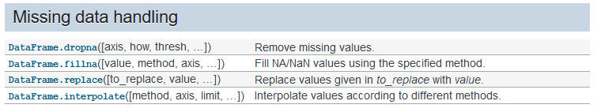
Data cleaning
A few data cleaning operations
These functions may be used on dataframes and series (columns)
Each function accepts parameters (arguments) that specifies its behaviour
As always, the documentation is quite helpful
https://pandas.pydata.org/pandas-docs/stable/reference/frame.html#missing-data-handling

Slide 52
Aggregation
The process of aggregation is to turn multiple values into one single value.
 | Destination | Sales
0 | Barcelona | 15
1 | Heraklion | 12
2 | Heraklion | 8
3 | Barcelona | 13
4 | Valencia | 12
5 | Barcelona | 17

Slide 53
Aggregation
The process of aggregation is to turn multiple values into one single value.
df.groupby(‘Destination’)[‘Sales’].mean()
Group variable (one or more)
Aggregate variable (one or more)
Aggregation function (one or more*)
 | Destination | Sales
0 | Barcelona | 15
1 | Heraklion | 12
2 | Heraklion | 8
3 | Barcelona | 13
4 | Valencia | 12
5 | Barcelona | 17
 | Destination | Avg_sales
0 | Barcelona | 15
1 | Heraklion | 10
2 | Valencia | 12

Slide 54
Aggregation
The process of aggregation is to turn multiple values into one single value.
df.groupby(‘Destination’)[‘Sales’].mean()
Group variable (one or more)
Aggregate variable (one or more)
Aggregation function (one or more*)
 | Destination | Sales
0 | Barcelona | 15
1 | Heraklion | 12
2 | Heraklion | 8
3 | Barcelona | 13
4 | Valencia | 12
5 | Barcelona | 17
 | Destination | Avg_sales
0 | Barcelona | 15
1 | Heraklion | 10
2 | Valencia | 12

Slide 55
Aggregation
The goal of aggregating is to turn multiple values into one single value.
df.groupby(‘Destination’)[‘Sales’].mean()
Group variable (one or more)
Aggregate variable (one or more)
Aggregation function (one or more*)
df.groupby([‘Origin’, ‘Destination’])[[‘Sales’, ‘Passengers’]].mean()
For multiple group levels, wrap variables in a list.
For multiple aggregation variables, wraps list of variables in a list
df.groupby([‘Origin’, ‘Destination’]).agg({‘Sales’: [‘sum’, ‘mean’], ‘Passengers’: [‘sum’]})
For multiple aggregations over multiple variables, use .agg() and use a dictionary.

Slide 56
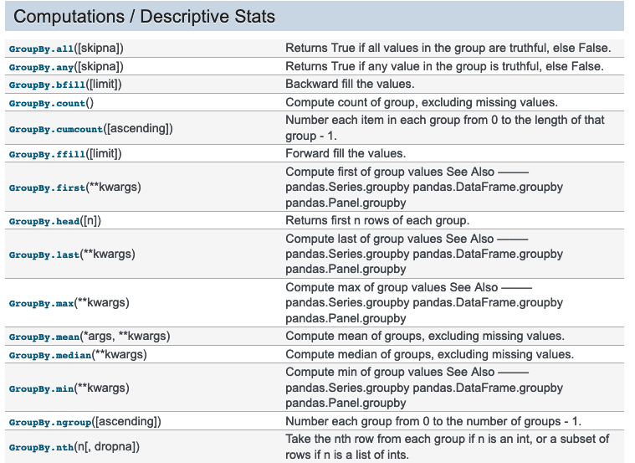
Aggregation
There are tons of built-in functions that work on grouped data. You can even write your own!
https://pandas.pydata.org/pandas-docs/stable/reference/groupby.html

Slide 57
Exercise
Data wrangling with Pandas

Slide 58
Data wrangling with Pandas
http://tinyurl.com/rywmvn6

Slide 59
Bonus assignment
https://tinyurl.com/u8sostr

Slide 60
Done!

